Slide 1

The Transformative Power of Poetry
A Case Study:
Mihai Eminescu &
Amita Bhose
Author: Constantin Hărăbor
Event: WCP Monterrey 2025

Slide 2

MOTTOS
“Dear friends, poetry carries a rhythm that speaks to the soul, offering a soothing escape from life’s demands. Whether we read or recite, poetry has the power to calm the mind, ease the heart, and invite reflection. In its gentle cadence, we find a moment of peace—a quiet sanctuary in words.
Let’s share the beauty of poetry together!”
Anișoara Laura Mustețiu - poet, Sydney, Australia
“In the silence between two verses of Eminescu lies the soul of the Romanian nation.”
Claudia Motea – Romanian-Canadian actress and poet
“Mihai Eminescu is the only European poet who made India immortal in his country.”
Amita Bhose, Indian-Romanian Eminescu scholar

Slide 3
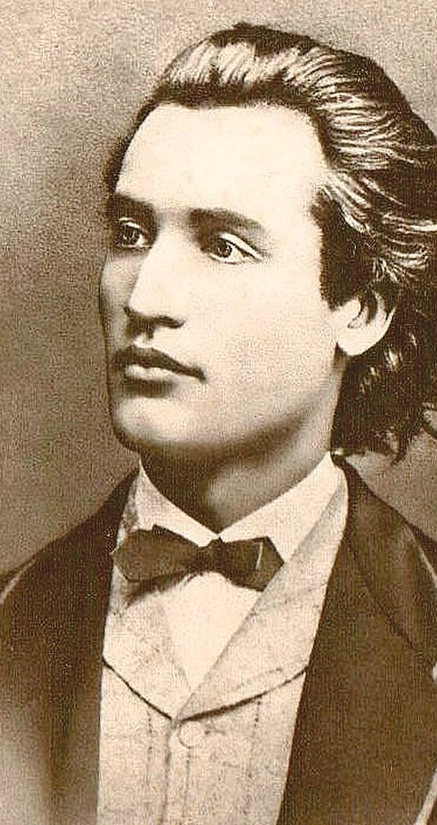
Introduction
Poetry is more than art. It’s a form of deep communication — across cultures, languages, and time.
This is the story of how the poetry of Mihai Eminescu shaped the life of a brilliant woman from India — Amita Bhose.
Through her, Romanian literature found a new voice on the Asian continent.

Slide 4
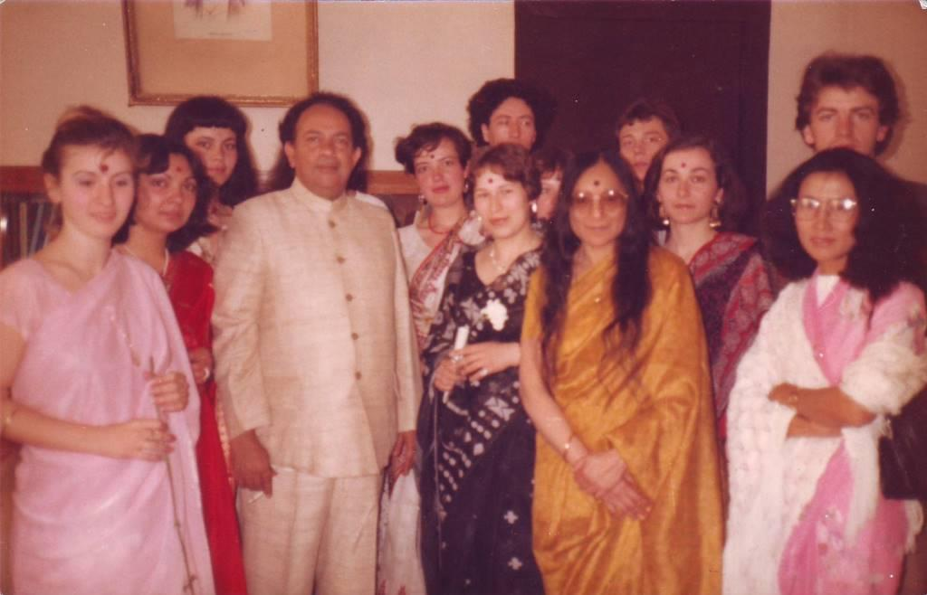
Who was Amita Bhose?
Born in 1933 in Calcutta, India, into a highly intellectual family.
Her relatives worked closely with Mahatma Gandhi and were involved in politics, science, and the arts.
Amita graduated in Math, Physics, and Chemistry. But her real passion? Language, literature, and cultural exchange.

Slide 5
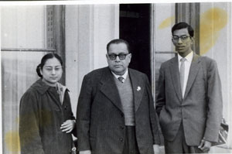
First Encounter with Eminescu AND ROMANIA
In 1959, she came to Romania with her husband.
She enrolled in a Romanian language course — and discovered the poem “Ce te legeni, codrule”.
That poem changed everything.
It sparked a lifelong fascination with Mihai Eminescu’s work.

Slide 6
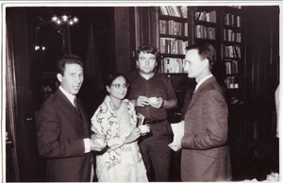
Her Cultural Mission
Back in India, she became a cultural journalist and began writing about Romanian literature.
She published in both Bengali and English.
She joined major cultural associations in India and abroad.
Her mission: build bridges between Romanian and Indian culture.

Slide 7
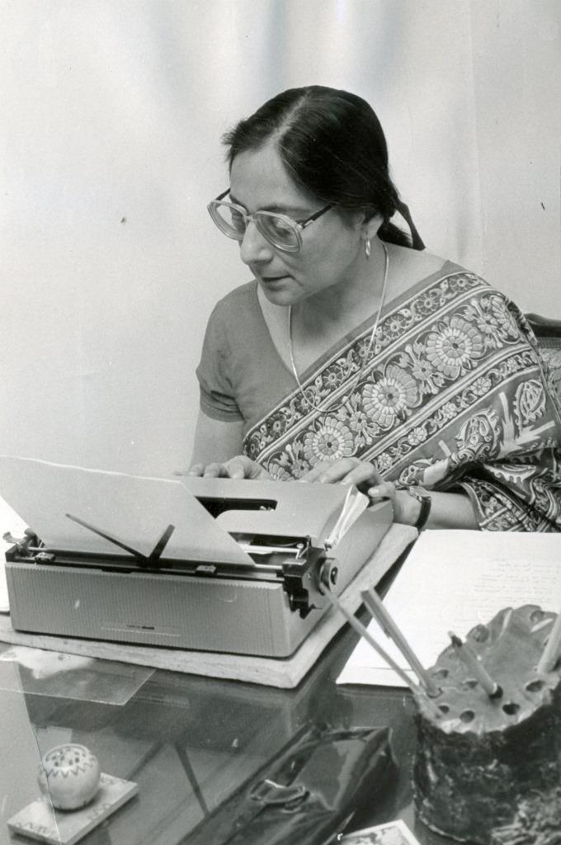
Translating Eminescu
In 1969, she published Eminescu: Kavita – a collection of 35 of his poems, translated into Bengali.
This was the first Eminescu translation in India and only the second in all of Asia.
She said: “I didn’t just translate words — I tried to live his anguish, to understand the soul behind the lines.”

Slide 8
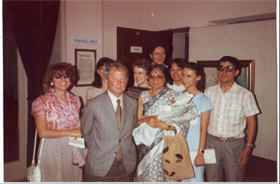
Academic Work in Romania
She returned to Romania, earned her PhD with a thesis on Indian influence in Eminescu’s thinking.
Her supervisor? Zoe Dumitrescu-Bușulenga.
She taught Bengali and Indian Civilization at the University of Bucharest.
She was awarded the Writers’ Union Prize for her translations.

Slide 9
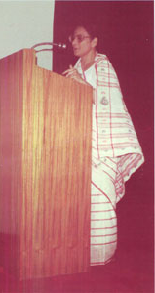
Literary & Scientific Contributions
She contributed to the scientific edition of Eminescu’s works.
She led a study group on Indian philosophy and literature.
She published essays on how Indian thought influenced Eminescu’s prose and poetry.
She shaped how future generations understood the poet’s deeper roots.

Slide 10
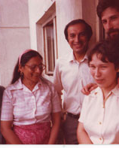
The Final Years
In 1992, after a trip to India, she returned to Romania ill but fulfilled.
She ignored signs of hepatitis and continued working until the very end.
She passed away in October that year.
Her ashes were kept in Romania, the country she had grown to love deeply.

Slide 11
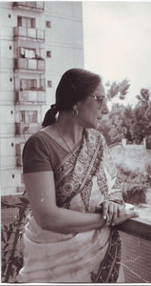
Final Thoughts
For Amita Bhose, poetry wasn’t just beauty — it was destiny.
Through Eminescu, she found a second homeland.
Through her, Romania found a voice in the East.
This is what poetry can do: connect souls across worlds.

Slide 12
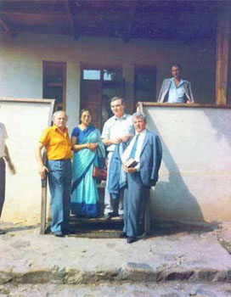
Memorable Quotes
“Translating Eminescu was not a linguistic exercise. It was a spiritual journey.” — Amita Bhose
“She served Romanian culture with more passion than many Romanians.” — Zoe Dumitrescu-Bușulenga

Slide 13
Sources
Amita Bhose – Biografie
Bhose, A. Eminescu și India, 2015
Bhose, A. Indian Tides: Indo-Romanian Cultural Intersections, 1998
Bhose, A. Eminescu: Essays & Reflections, 2001

